Slide 1
Network Identity Manager Version 2
Jeffrey Altman,
Asanka Herath

Slide 2
Identity Providers
Network Identity Manager 1.x
Network Identity Manager 2.x
Limited to one identity provider
  Only Kerberos 5 identities
  Other credential types cannot be used to define an identity
  Plug-ins needed workarounds/hacks
Allows multiple identity providers
  Kerberos 5
  KeyStore
  Generic X.509

Slide 3
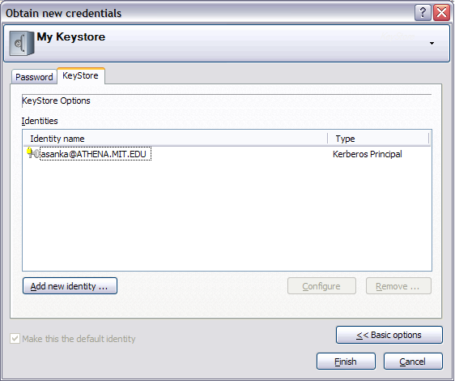
KeyStore Identity Provider
Problems
  Users have to keep track of passwords for multiple identities.
  User have to initialize each identity separately.
Allows the acquisition of credentials for multiple identities from one local authentication

Slide 4
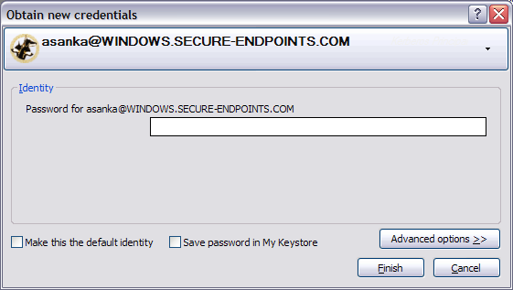
Initial Credentials
Problem:
  Users have to enter username, realm and password separately
Known identities are selected from a list

Slide 5
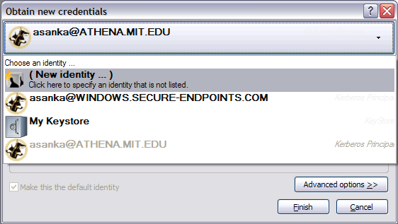
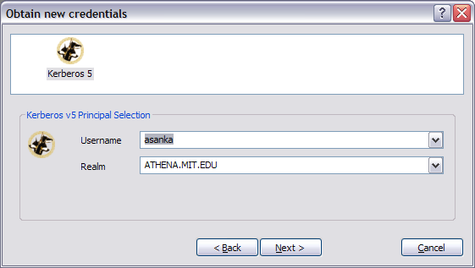
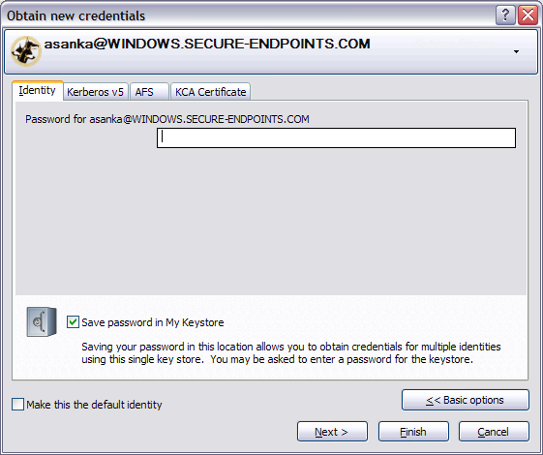
Initial Credentials
Problem:
  Too complicated to configure a new identity
  Each credential type must be configured individually
New Identity Configuration Wizard
  Walks the user through options for each configuration page for a new identity

Slide 6
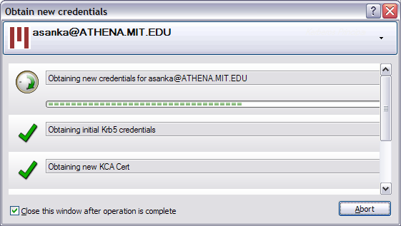
Initial Credentials
  Not enough feedback on lengthy operations
Progress reporting per subtask

Slide 7
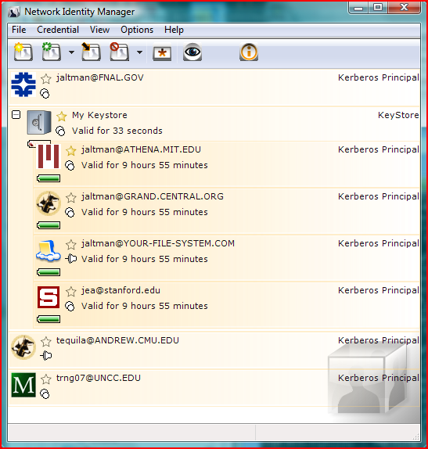
Credentials Display
Can associate an icon with an identity
  Recognizable
Interactive widgets

Slide 8
Demo

